Slide 1
Launch Kits Overview
Last update: January 2020

Slide 2
Launch Kit Email Summary
Week | First Year (FYLK) New Assoc4. & Consultants & Gamma¹ | Week | Project Leader (PLLK) Newly Promoted PLs & Gamma² | Week | Senior Hire (SHLK) New PL, Pr, AD, D & Gamma³ | Week | Teaming For Commercial Success (TFCS) For AD/D only
1 | Managing Your Module Managing Your Module | 1 | Project Management Project Management | 1 | Your Learning Journey Begins Intro to BCG Project Management Proposal Excellence | 1 | Expand your commercial expertise Teaming for Commercial Success Link to trainings
2 | Slidewriting & PowerPoint Slidewriting PowerPoint at BCG | 8 | Giving Developmental Project Feedback Giving Developmental Project Feedback | 3 | Continue Your Learning Journey Slidewriting Storylining Managing Your Module Giving Dev Project Feedback | 12 | Expand your commercial expertise 1st Reminder to complete Link to trainings
3 | Teaming with Your Client Teaming with Your Client | 12 | Introduction to Alteryx & Tableau Introduction to Alteryx & Tableau | 6 | Your Road to Success Giving Dev Project Feedback PTO Problem Solving Time Management | 25 | Expand your commercial expertise 2nd Reminder to complete Link to trainings
4 | Effective Research Effective Research at BCG | 16 | Proposal Excellence Proposal Excellence
5 | Problem Solving Problem Solving
6 | What do you want to learn today? No topics – link to browse

Slide 3
FYLK Emails

Slide 4
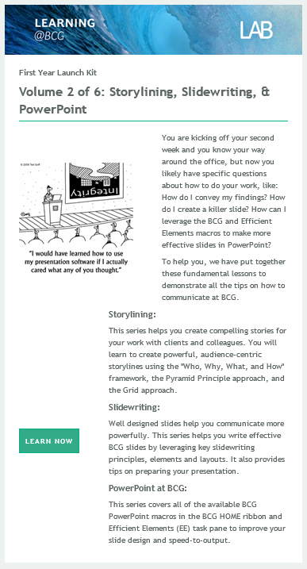
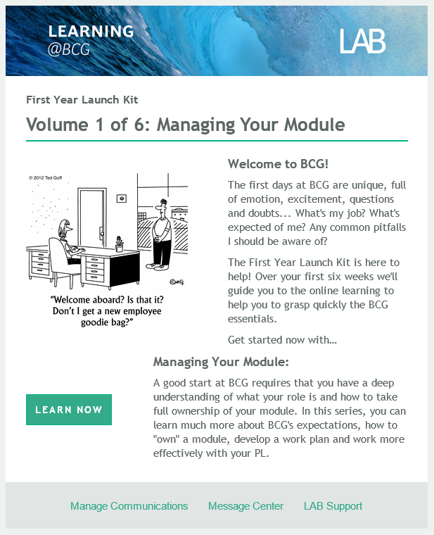
FYLK Volume 1 & 2

Slide 5


FYLK Volume 3 & 4

Slide 6
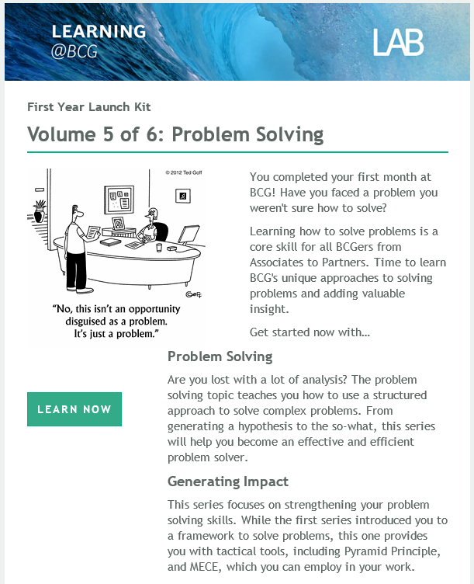

FYLK Volume 5 & 6

Slide 7
PLLK Emails

Slide 8
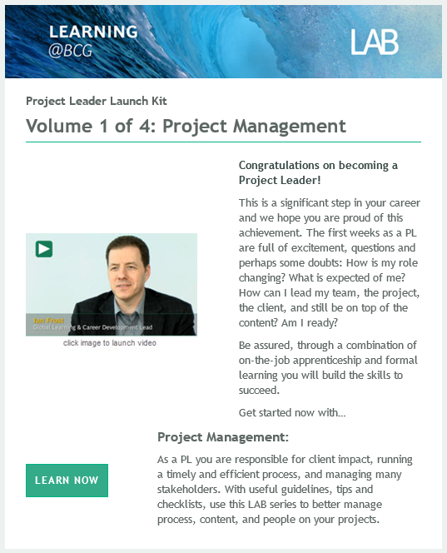
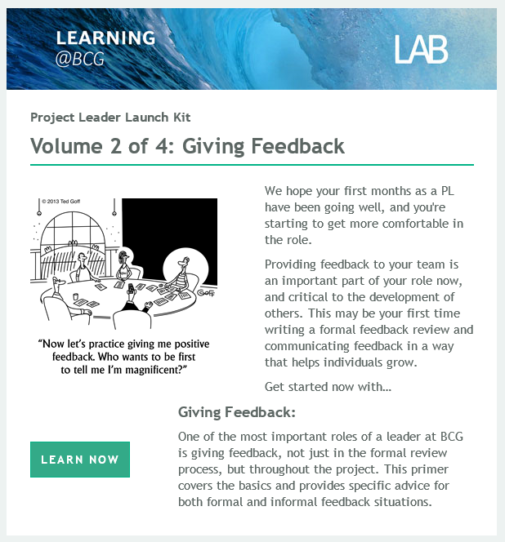
PLLK Volume 1 & 2

Slide 9
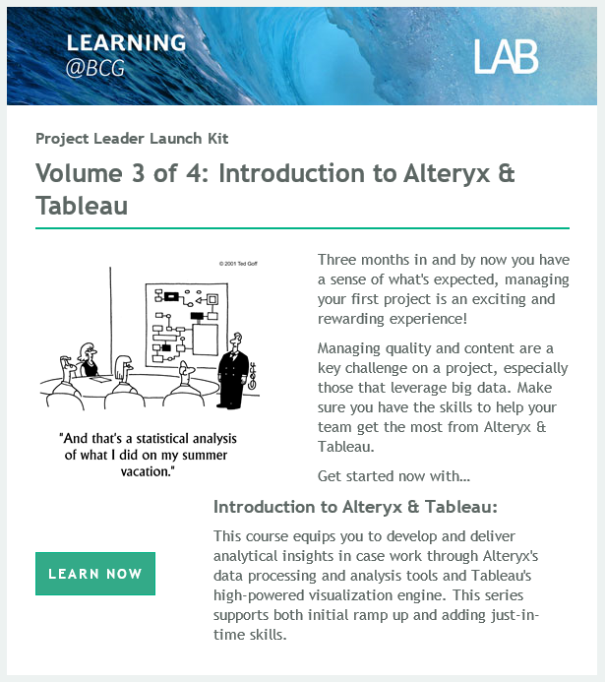

PLLK Volume 3 & 4

Slide 10
SHLK Emails

Slide 11
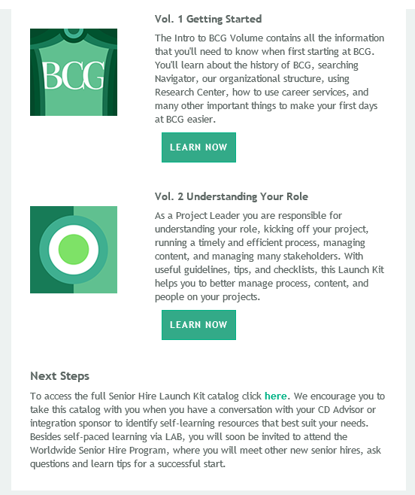
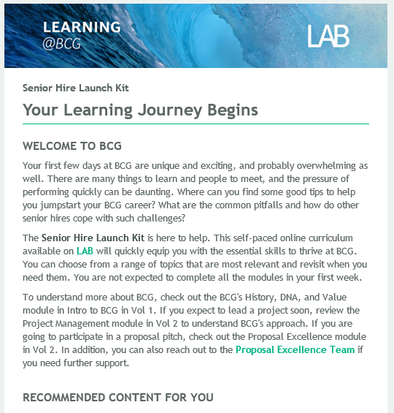
SHLK Email #1 – Volumes 1 & 2

Slide 12
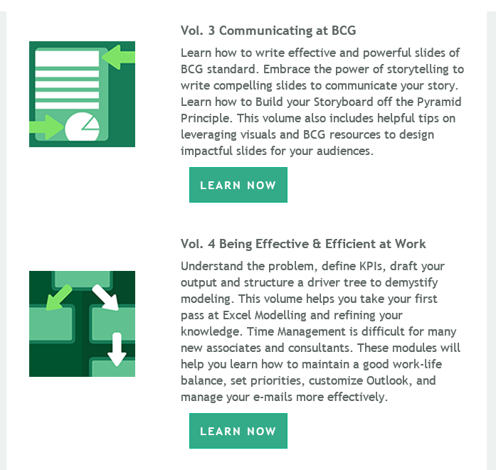
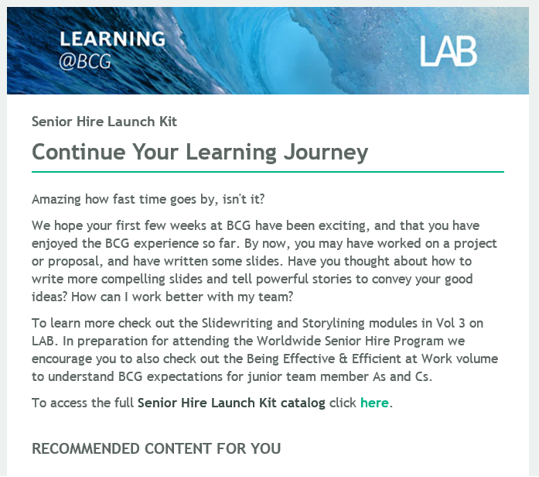
SHLK Email #2 – Volumes 3 & 4

Slide 13
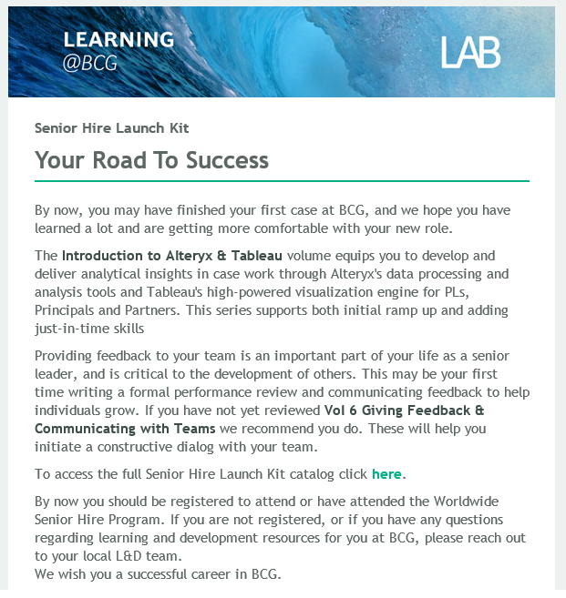
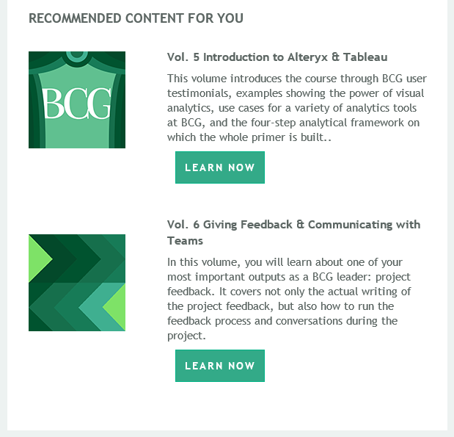
SHLK Email #3 – Volumes 5 & 6

Slide 14
TFCS Emails

Slide 15

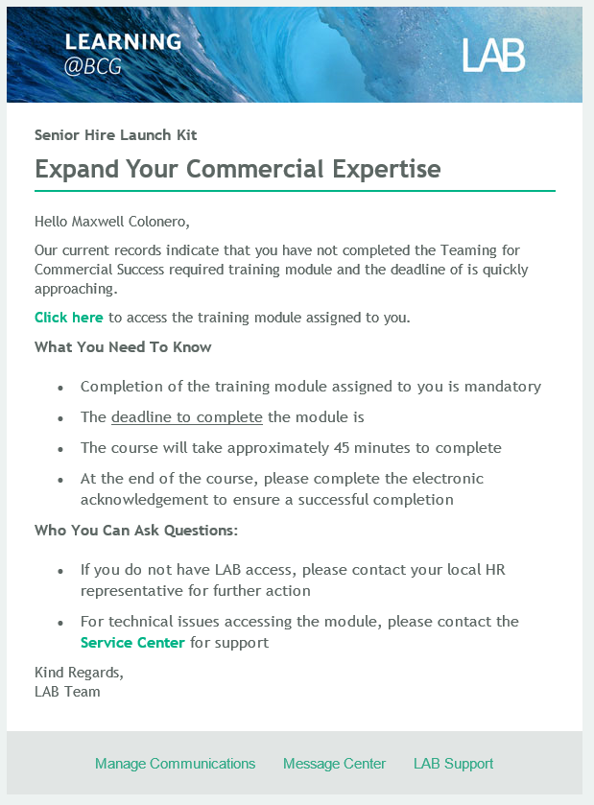
TFCS Assignment Email & Reminder 1&2

